Slide 1

Data Challenge – Fraud detection
Junzhe Zhang
Data scientist
zhangjunzhe8868@gmail.com

Slide 2
Outline
Introduction
Approach and Analysis
Summary
Questions

Slide 3
Introduction - Problem statement
Fraud is a problem for any bank and it is a cost of bank.
Fraud can take many forms, whether it is someone stealing a single credit card, to large batches of stolen credit card numbers being used on the web, or even a mass compromise of credit card numbers stolen from a merchant via tools like credit card skimming devices.
We want to build a classification model to detect the fraud at transaction level.
Assumption: the sampling method is correct and the label is correct.

Slide 4
Approach and Analysis – Data exploration
Raw data has 29 attributes and 786363 records, which is labeled.
Some variables have null values.
Some variables are exactly same with others.
Some variables are continuous and the others are categorical.
There label of fraud and non-fraud are imbalanced (fraud transaction takes only 1.579%).
All transactions were made between 2016-1-1 to 2016-12-31.
All transactions were made in US, MEX, CAN, and PR.
Card present transaction has less fraud.
Mismatched CVV and expiration date has no fraud because the transaction cannot be processed.
posEntryMode has a different pattern on fraudulent samples.

Slide 5
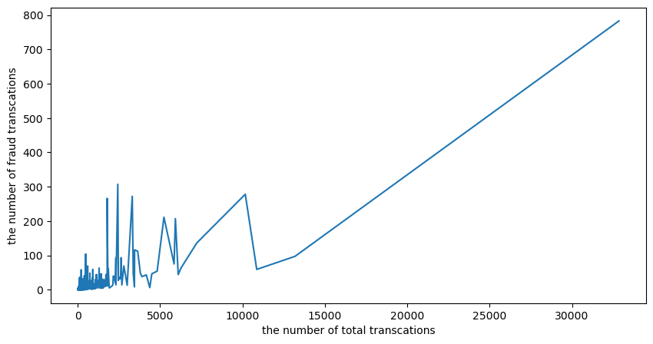
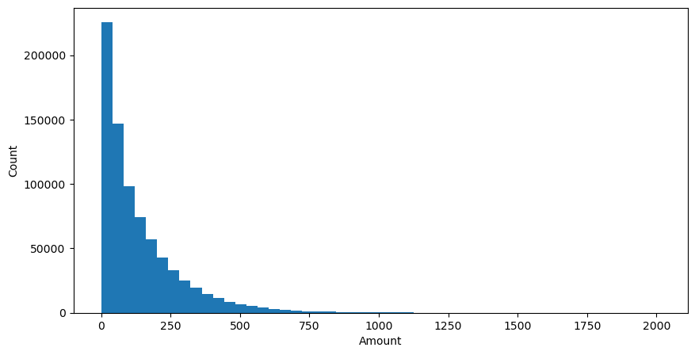
Approach and Analysis – Data exploration
Some accounts have significantly more fraudulent transactions than others.
Most of transaction is a small amount transaction.
AMC, EZ Putt Putt, Uber, Lyft, oldnavy.com are the most popular place for using this card.
online_retail, fastfood, entertainment, food, online_gifts are the most popular categories.

Slide 6
Approach and Analysis – Data cleaning
Dropped off the variables that all values are null.
Dropped off the variables that are duplicated with others.
Dropped off the variables that a major category took more than 90%.
Converted time data to a time data format.
Group the variables into numeric and categorical (ordinal data was treated like numeric data).

Slide 7
Approach and Analysis – Feature engineering
Categorized the transaction amount
Categorized the duration of opening account
Categorize the duration of changing address
Added a new feature for fraud ratio for each customer id
Added a new feature to show the ratio of Fr customer and NFr customer in the merchantCategoryCode
Added a new feature to show the ratio of Fr customer and NFr customer in the merchantNameClean
Time data converted into new features such as night/day and weekend/weekday

Slide 8
Approach and Analysis – predictive model
75% training and 25% testing.
For imbalanced data, there are two ways to deal with it:
random oversampling of minority and random undersampling of majority in training data.
added a class-weighted in loss function (more penalty if a minority was misclassified).
One-hot coding for categorical data.
Model: logistic regression and random forest
Grid search to do the hyperparameter tunning
Report the feature importance
Model optimization (kicked out the less importance features)

Slide 9
Approach and Analysis – model evaluation
Metrics: auc score, precision-recall curve, precision, false alarm rate, and accuracy score.
precision and false alarm rate are important since a false alarm can lead to a bad customer experience but a missing can be detected by other models.

Slide 10
Summary
There are four steps for doing this project: data exploration, feature engineering and data cleaning, building baseline and ML models, and model evaluation.
Some anomaly detection methods were tried in this study, such as Local Outlier Factor and Isolation Forest.
For feature engineering, TomekLinks method was tried for undersampling the majority class, but it is too slow.
Next step: model implementation (big data or on-time) and model monitoring (model retrain)
This model is a starting point but need more models to work together, such as model can detect the missing fraudulent transaction from this model or the model checking for some big transactions.

Slide 11
References
Sadineni, Praveen Kumar. "Detection of fraudulent transactions in credit card using machine learning algorithms." 2020 Fourth International Conference on I-SMAC (IoT in Social, Mobile, Analytics and Cloud)(I-SMAC). IEEE, 2020.
Maniraj, S. P., et al. "Credit card fraud detection using machine learning and data science." International Journal of Engineering Research 8.9 (2019): 110-115.
Credit Card Activities Manual, https://www.fdic.gov/regulations/examinations/credit_card/pdf_version/

Slide 12
Questions?
Thank you

